Slide 1
Gates
Six types of gates
NOT
AND
OR
NAND
NOR
EX-OR
EX-NOR
Basic Gates : NOT, AND, OR
Universal Gates : NAND, NOR
Special Gates Purpose Gates : Ex-OR, Ex- NOR. They are used for arithmetic circuit, Comparators, code conversion, parity gen & checker etc.
How do we describe the behavior of gates and circuits?
Boolean expressions :- Uses Boolean algebra, a mathematical notation for expressing two-valued logic
Logic diagrams :- A graphical representation of a circuit; each gate has its own symbol
Truth tables : A table showing all possible input value and the associated output values

Slide 2
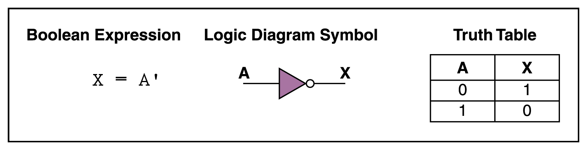
NOT Gate
A NOT gate accepts one input signal (0 or 1) and returns
the opposite signal as output

Slide 3
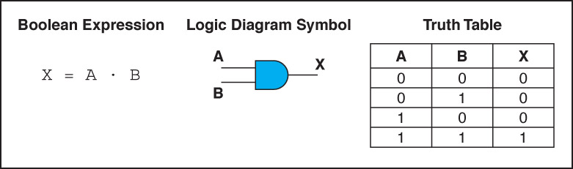
AND Gate
An AND gate accepts two input signals
If both are 1, the output is 1; otherwise, the output is 0

Slide 4
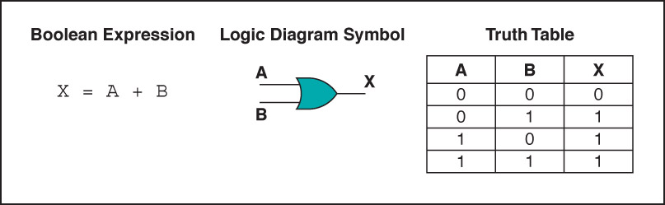
OR Gate
An OR gate accepts two input signals
If both are 0, the output is 0; otherwise, the output is 1

Slide 5
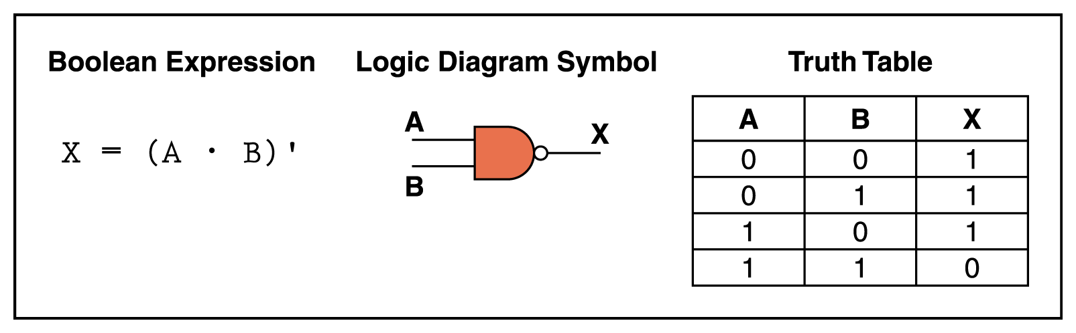
NAND Gate
The NAND gate accepts two input signals
If both are 1, the output is 0; otherwise, the output is 1

Slide 6
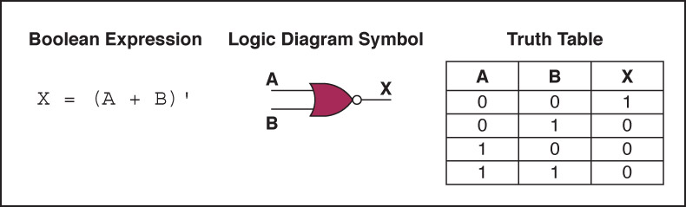
NOR Gate
The NOR gate accepts two input signals
If both are 0, the output is 1; otherwise,
the output is 0

Slide 7
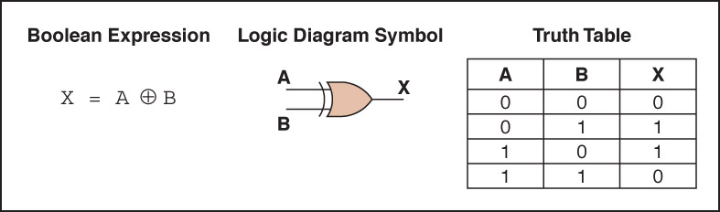
EX-OR Gate
An XOR gate accepts two input signals
If both are the same, the output is 0; otherwise,
the output is 1

Slide 8
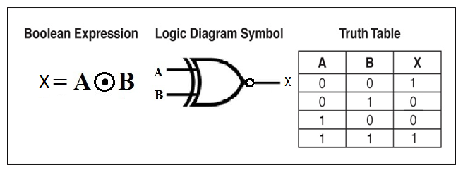
EX-NOR Gate
An XOR gate accepts two input signals
If both are the same, the output is 1; otherwise,
the output is 0

Slide 9
Review of Gate Processing
A NOT gate inverts its single input
An AND gate produces 1 if both input values are 1
An OR gate produces 0 if both input values are 0
A NAND gate produces 0 if both inputs are 1
A NOR gate produces a 1 if both inputs are 0
An EX-OR gate produces 0 if input values are the differ
An EX-NOR gate produces 0 if input values are the Same

Slide 10
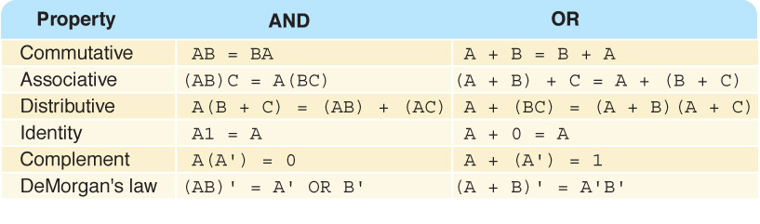
Properties of Boolean Algebra

Slide 11
Simplification Goals
Goal -- minimize the cost of realizing a switching function
Cost measures and other considerations
Number of gates
Number of levels
Gate fan in and/or fan out
Interconnection complexity
Two-level realizations
Minimize the number of gates (terms in switching function)
Minimize the fan in (literals in switching function)

Slide 12
Minimization Methods
Commonly used techniques
Boolean algebra postulates and theorems
Karnaugh maps
Quine-McCluskey method
Petrick’s method
Generalized concensus algorithm
Characteristics
Heuristics (suboptimal)
Algorithms (optimal)

Slide 13
Standard SOP and POS form
Standard SOP and POS form has all the variables in all the terms
A non-standard SOP is converted into standard SOP by using the rule
A non-standard POS is converted into standard POS by using the rule

Slide 14
Standard SOP form
Notes:
A standard SOP form has product terms that have all the variables in the domain of the expression.
The SOP expression AC* +BC* is not a standard SOP as the domain of the expression has variables A, B and C.
To convert the non-standard SOP into a standard SOP the rule A+A*=1 is used
Applying the rule to expression AC* + BC* converts it into a standard SOP form ABC*+AB*C*+A*BC* each product term having the three variables A, B and C

Slide 15
Standard POS form
Notes:
A standard POS form has sum terms that have all the variables in the domain of the expression.
The POS expression having the three sum terms (A+B*+C), (A+B+D*) and (A+B*+C*+D) is not a standard POS as the domain of the expression has variables A, B, C and D.
To convert the non-standard POS into a standard POS the rule AA*=0 is used
Applying the rule to expression converts it into a standard POS form each of the five sum terms having the four variables A, B, C and D

Slide 16
Why Standard SOP and POS forms?
Minimal Circuit implementation by switching between Standard SOP or POS
Alternate Mapping method for simplification of expressions
Minterms: Product terms in Standard SOP form
Maxterms: Sum terms in Standard POS form
Notes:
Any logic circuit can be implemented by using either the SOP, AND-OR combination of gates or POS, OR-AND combination of gates. It is very simple to convert from standard SOP to standard POS or vice versa. This helps in selecting an implementation that requires the minimum number of gates.
Secondly, the simplification of general Boolean expression by applying the laws, rules and theorems does not always result in the simplest form as the ability to apply all the rules depends on ones experience and knowledge of all the rules.
A simpler mapping method uses Karnaugh maps to simplify general expressions. Mapping of all the terms in a SOP form expression and the sum terms in a POS form can be easily done if standard forms of SOP and POS expressions are used. Karnaugh maps will be discussed latter in the chapter.
Lastly, the PLDs are implemented having a general purpose structure based on AND-OR arrays. A function represented by an expression in Standard SOP form can be readily programmed.

Slide 17
Minterms and Maxterms & Binary representations
A | B | C | Min-terms | Max-terms
0 | 0 | 0
0 | 0 | 1
0 | 1 | 0
0 | 1 | 1
1 | 0 | 0
1 | 0 | 1
1 | 1 | 0
1 | 1 | 1

Slide 18
SOP-POS Conversion
Minterm values present in SOP expression not present in corresponding POS expression
Maxterm values present in POS expression not present in corresponding SOP expression

Slide 19
SOP-POS Conversion
Canonical Sum
Canonical Product
Notes:
The 5 sum term standard SOP expression has the binary values 000, 010,011,101 and 111.
The expression is represented in Canonical Sum form where the variables A,B and C define the domain of the expression. The numbers 0,2, 3, 5 and 7 represent the Minterms present in the SOP expression.
The missing binary values are 001, 100 and 110.
The equivalent POS expression has the corresponding missing 3 terms as sum terms 1, 4 and 6
The expression is represented in Canonical Product form where the variables A, B and C define the domain of the expression. The numbers 1, 4 and 6 represent the MAxterms present in the POS expression.
If the 3 sum terms are multiplied together and the expression is solved, it results in the 5 sum term SOP expression

Slide 20
Boolean Expressions and Truth Tables
Standard SOP & POS expressions converted to truth table form
Standard SOP & POS expressions determined from truth table

Slide 21
SOP-Truth Table Conversion
Input |  |  | Output
A | B | C | F
0 | 0 | 0 | 0
0 | 0 | 1 | 0
0 | 1 | 0 | 0
0 | 1 | 1 | 1
1 | 0 | 0 | 1
1 | 0 | 1 | 1
1 | 1 | 0 | 0
1 | 1 | 1 | 1
Notes:
The steps involved in representing a SOP expression in a truth table are to first convert the non-standard SOP expression into standard SOP expression.
In the next step the minterms present in the standard SOP expression are marked as 1s in the truth table output column.
The remaining minterms that are not present in the SOP expression are marked as 0s in the output column of the truth table.
A standard SOP can be determined from the truth table by writing out all the minterms marked by 1s in the output column of the truth table.

Slide 22
POS-Truth Table Conversion
Input |  |  | Output
A | B | C | F
0 | 0 | 0 | 1
0 | 0 | 1 | 0
0 | 1 | 0 | 0
0 | 1 | 1 | 0
1 | 0 | 0 | 1
1 | 0 | 1 | 0
1 | 1 | 0 | 1
1 | 1 | 1 | 1
Notes:
The steps involved in representing a POS expression in a truth table are to first convert the non-standard POS expression into standard POS expression.
In the next step the maxterms present in the standard POS expression are marked as 0s in the truth table output column.
The remaining maxterms that are not present in the POS expression are marked as 1s in the output column of the truth table.
A standard POS can be determined from the truth table by writing out all the maxterms marked by 0s in the output column of the truth table.

Slide 23
What is minimization?
Simplifying Boolean expressions
Algebraic manipulations is hard since there is not a uniform way of doing it
Karnaugh map or K-map techniques is very commonly used

Slide 24
Karnaugh Maps (K-Maps)
A visual way to simplify logic expressions
It gives the most simplified form of the expression

Slide 25
Rules to obtain the most simplified expression
Simplification of logic expression using Boolean algebra is awkward because:
it lacks specific rules to predict the most suitable next step in the simplification process
it is difficult to determine whether the simplest form has been achieved.
A Karnaugh map is a graphical method used to obtained the most simplified form of an expression in a standard form (Sum-of-Products or Product-of-Sums).
The simplest form of an expression is the one that has the minimum number of terms with the least number of literals (variables) in each term.
By simplifying an expression to the one that uses the minimum number of terms, we ensure that the function will be implemented with the minimum number of gates.
By simplifying an expression to the one that uses the least number of literals for each terms, we ensure that the function will be implemented with gates that have the minimum number of inputs.

Slide 26
Three-Variable K-Maps

Slide 27
Four-Variable K-Maps

Slide 28
Four-Variable K-Maps

Slide 29
Design of combinational digital circuits
Steps to design a combinational digital circuit:
From the problem statement derive the truth table
From the truth table derive the unsimplified logic expression
Simplify the logic expression
From the simplified expression draw the logic circuit
Example: Design a 3-input (A,B,C) digital circuit that will give at its output (X) a logic 1 only if the binary number formed at the input has more ones than zeros.

Slide 30
Design of combinational digital circuits
Example: Design a 4-input (A,B,C,D) digital circuit that will give at its output (X) a logic 1 only if the binary number formed at the input is between 2 and 9 (including).

Slide 31
Don’t Care Conditions
A network is usually composed of sub-networks
Net-1 may not produce all combinations of A,B, and C
In this case, F don’t care about those combinations

Slide 32
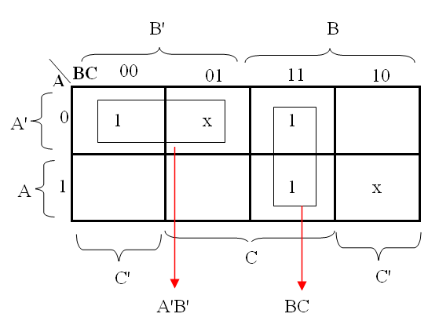
Don’t Care Conditions
X can be considered as 0 or 1, whichever is more convenient
0 0 0 1
0 0 1 x
0 1 0 0
0 1 1 1
1 0 0 0
1 0 1 0
1 1 0 x
1 1 1 1

Slide 33
Design the SOP and POS expression for the function
f(x₁, x₂, x₃, x₄) = Σ m(4, 6, 8, 10, 11, 12, 15) + D(3, 5, 7, 9)

Slide 34
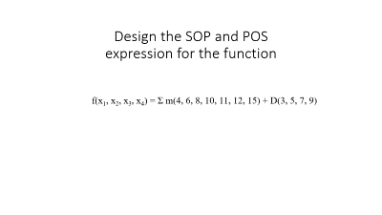
Let’s Use a K-Map
f(x₁, x₂, x₃, x₄) = Σ m(4, 6, 8, 10, 11, 12, 15) + D(3, 5, 7, 9)

Slide 35
Let’s Use a K-Map
f(x₁, x₂, x₃, x₄) = Σ m(4, 6, 8, 10, 11, 12, 15) + D(3, 5, 7, 9)
0
1
1
1
0
d
0
d
d
d
1
1
0
1
0
1

Slide 36
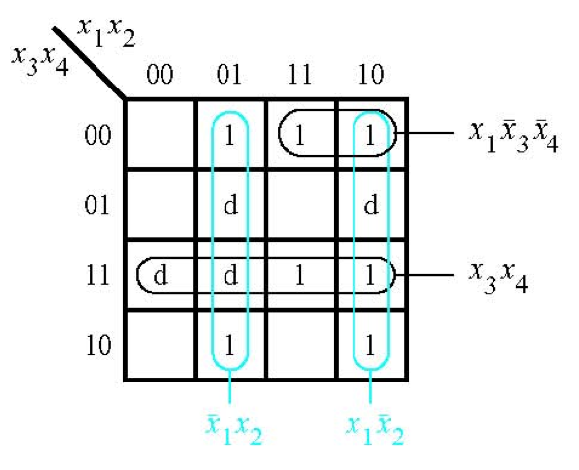
The SOP Expression

Slide 37
What about the POS Expression?
f(x₁, x₂, x₃, x₄) = Σ m(4, 6, 8, 10, 11, 12, 15) + D(3, 5, 7, 9)
0
1
1
1
0
d
0
d
d
d
1
1
0
1
0
1

Slide 38
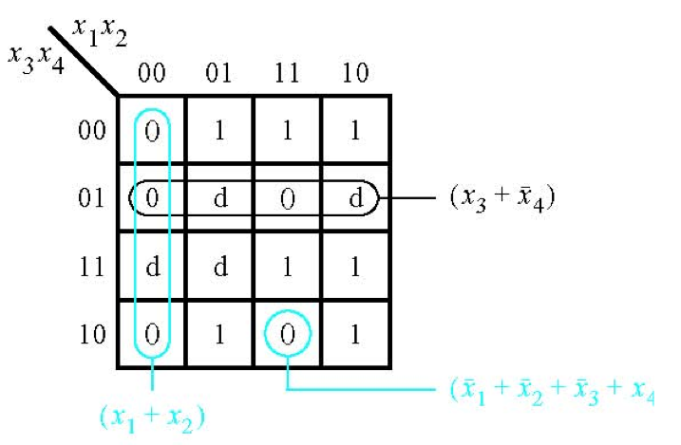
The POS Expression
[ Figure 2.67b from the textbook ]

Slide 39
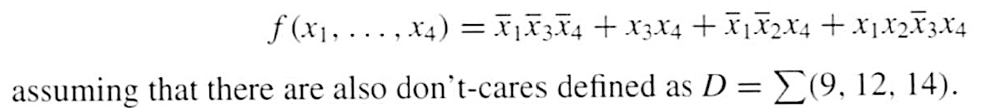
Use K-maps to find the SOP and POS expression for the function

Slide 40

Let’s map the expression to the K-Map

Slide 41
Let’s map the expression to the K-Map
d
d
d

Slide 42
Let’s map the expression to the K-Map
d
d
d

Slide 43
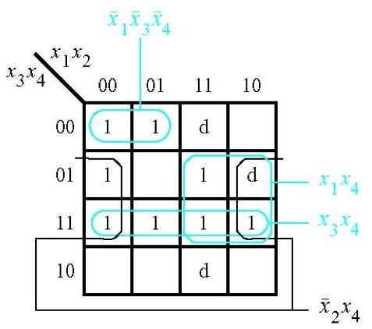

The SOP Expression

Slide 44
What about the POS Expression?
1
1
d
0
1
0
1
d
1
1
1
1
0
0
d
0

Slide 45
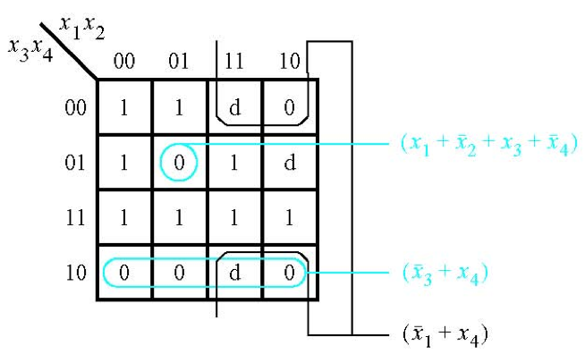

The POS Expression
[ Figure 2.68b from the textbook ]

